Slide 1
Diabetic Retinopathy (DR) severity Classification model
By Salah Ali

Slide 2
Objective
Aim : Build a deep learning model to classify retinal images into different stages of diabetic retinopathy based on the Kaggle challenge for this task
Scope :
The project will not focus on developing model with the highest accuracy.
It will be limited to Messidor-2 dataset, where data will be split into training and testing
We will explore two of the most common deep learning architecture for classification (DensNet, and ResNet)
We will use the commonly used / default parameters
Testing coverage for the code will be very preliminary
Deliverable
PowerPoint presentation
Zip file containing the scripts, and trained model
Readme file for usage instructions

Slide 3
Project stages
Data collection
Collect data from Kaggle Messidor-2 dataset
Model development
The focus of this project is not to provide the highest accuracy. Only two model architectures will be explored (DensNet, and ResNet)
Deployment
It will be limited to provide docker file
Literature review
Prepare a brief summary about DR
EDA Analysis
Explore data distribution Check data quality
Model evaluation
accuracy, precision, recall and F1 from the test, and training sets.
Include confusion matrix for your model.

Slide 4
Background

Slide 5
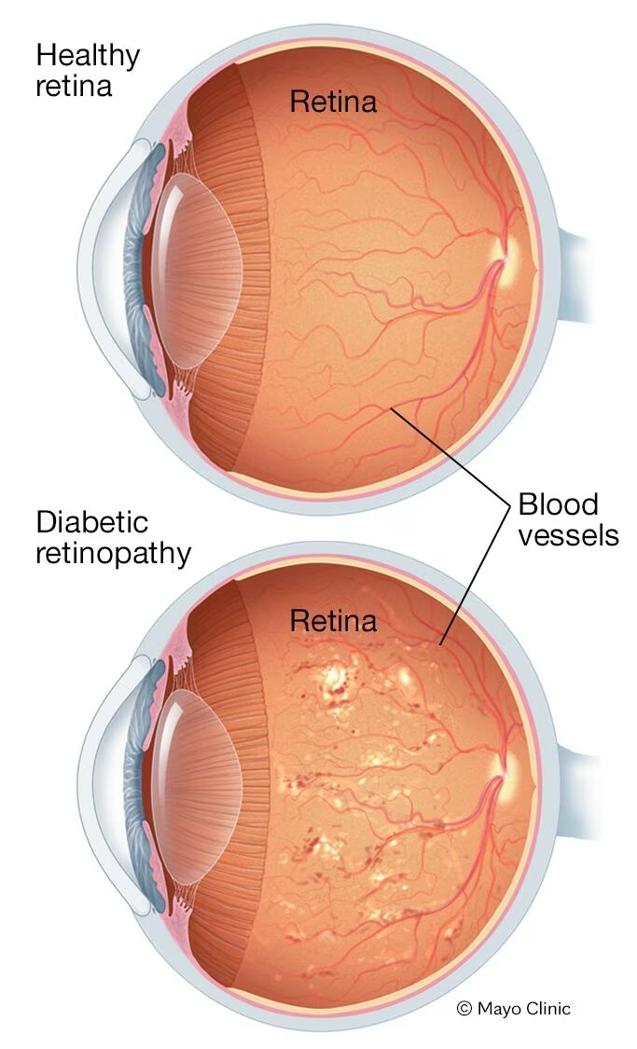
Background
Diabetic retinopathy is an eye condition that can cause vision loss and blindness in people who have diabetes. It affects blood vessels in the retina (the light-sensitive layer of tissue in the back of your eye) [1].
[1] https://www.nei.nih.gov
[2] https://www.mayoclinic.org
[2]

Slide 6
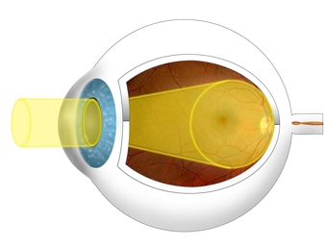
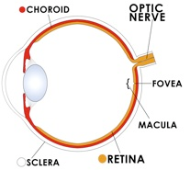
Medical imaging techniques for eye examination
Fundus photography: This is a non-invasive method that captures a high-resolution image of the back of the eye, including the retina, blood vessels, and optic nerve.

Slide 7
How Doctor diagnose and grade diabetic retinopathy (DR)
Doctors diagnose and grade diabetic retinopathy (DR) by examining high-resolution fundus photographs of the retina, and are graded based on the following:
No DR: No signs of damage.
Mild Non-Proliferative DR (NPDR): Early signs of DR, like microaneurysms or bleeding.
Moderate NPDR: More extensive microaneurysms, hemorrhages, and/or exudates.
Severe NPDR: Significant changes with possible cotton wool spots and/or signs of compromised blood flow.
Proliferative DR (PDR): Abnormal new blood vessels (neovascularization) grow on the retina's surface, potentially leading to vision loss if not treated.

Slide 8
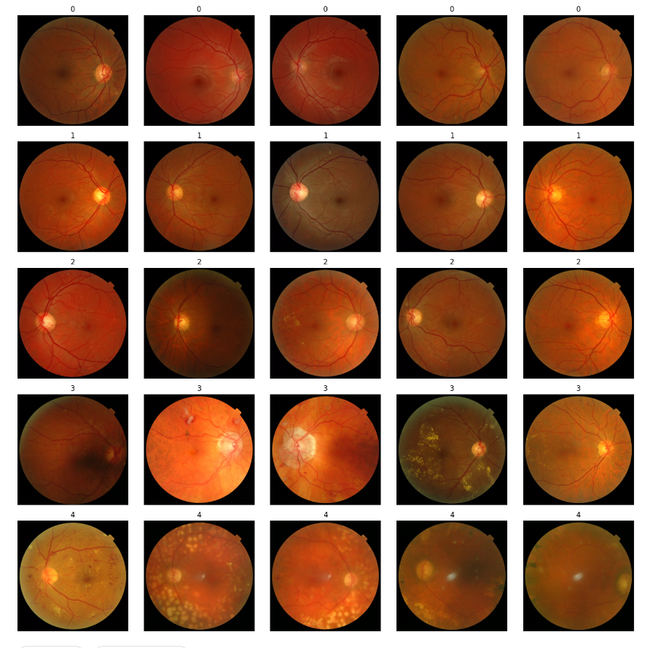
Messidor-2 dataset
International Diabetic Retinopathy Grading System (ICDR).
0: None
1: Mild DR
2: Moderate DR
3: Severe DR
4: Proliferative DR (PDR)
Figure 1: 5 examples for each class in Messidor-2 datasets

Slide 9
How common is diabetic eye disease?
On average, one in three people with diabetes will develop some form of diabetic eye disease.
Table 1: Diabetic Eye Disease Rates (AusDiab Study)
Type of Diabetic Eye Disease | Percentage
Non-proliferative retinopathy | 19.30%
Proliferative retinopathy | 2.10%
Macular edema | 3.30%
Table 2: Diabetic Eye Disease Rates in Melbourne Vision Impairment Project & Blue Mountains Eye Study
Finding | Melbourne Vision Impairment Project (>40 years old) | Blue Mountains Eye Study (>49 years old)
Diabetic retinopathy prevalence | 29.10% | 32.40%
Macular edema prevalence | 5.60% | 4.30%
Reference https://baker.edu.au/-/media/documents/impact/outofsightreport.pdf

Slide 10
Project development

Slide 11
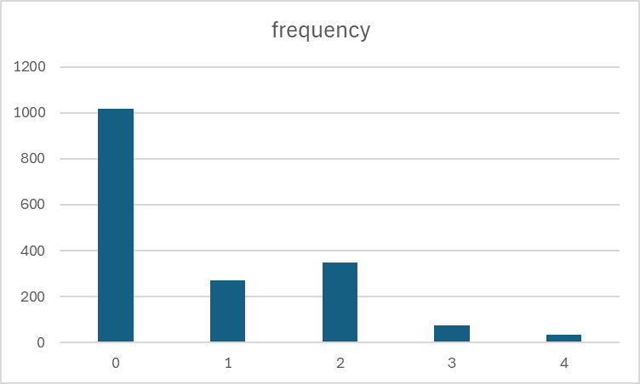
EDA
The dataset has unbalanced classes, where the majority of images corresponding to healthy patients

Slide 12
Quality checks
All datasets have the same size 512x512x3.
All images have the same image type (png)
All images contain the fundus only. If we add any more datasets, then they need to be cropped if they contain background region.
By Visually inspecting few images randomly, we can tell the changes of vessels, tiny bulges, Cotton wool spots in images classified with DR

Slide 13
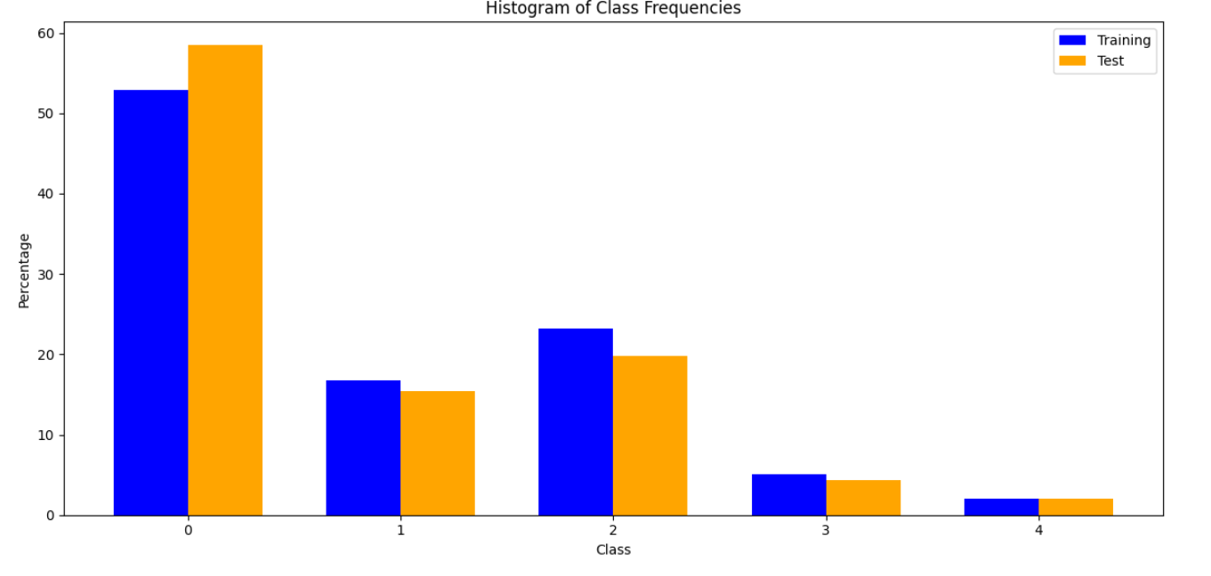
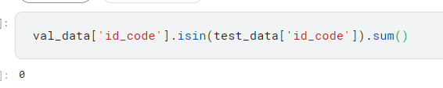
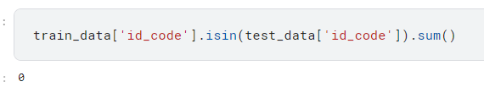
Split datasets
Datasets is splitted using StratifiedShuffleSplit, so we can get all classes in both training, and testing
It’s very important to check data leakes

Slide 14
Data augmentation / pre-processing
We will use two types of augmentation :
Rotation of images between -10° to 10°
We will use two types of data preprocessing :
Max min normalisation, as most of deep learning models work best with normalised dataset
Resize the images into 256x256, as most of pre-trained models accept images with this size

Slide 15
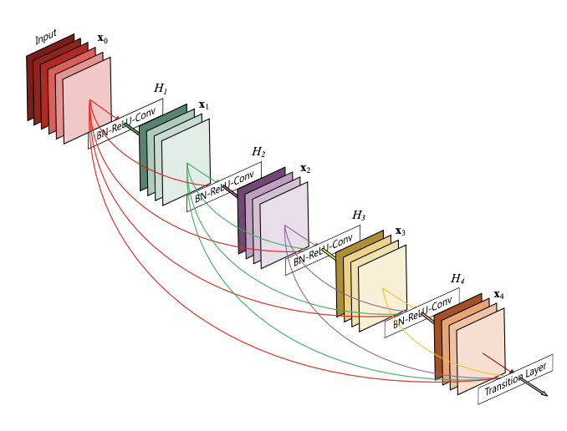
Model selection
Dense Convolutional Network (DenseNet), connects each layer to every other layer in a feed-forward fashion.

Slide 16
Model training
Learning rate As we are exploring different models, then we used adaptive learning rate to start with a large learning rate and end with a smaller rate. scheduler = ReduceLROnPlateau(optimizer, mode='max', factor=0.5, patience=20, verbose=True)
Loss Function We used the most common loss function for multiclass classification task Cross Entropy Loss. As the classes were unbalanced, the optional argument weight is used
Transfer learning The model layers will be freezed, except few layers for re-training.
Epochs We will choose epochs between 10-20, and keep track of the performance of the model on the validation dataset

Slide 17
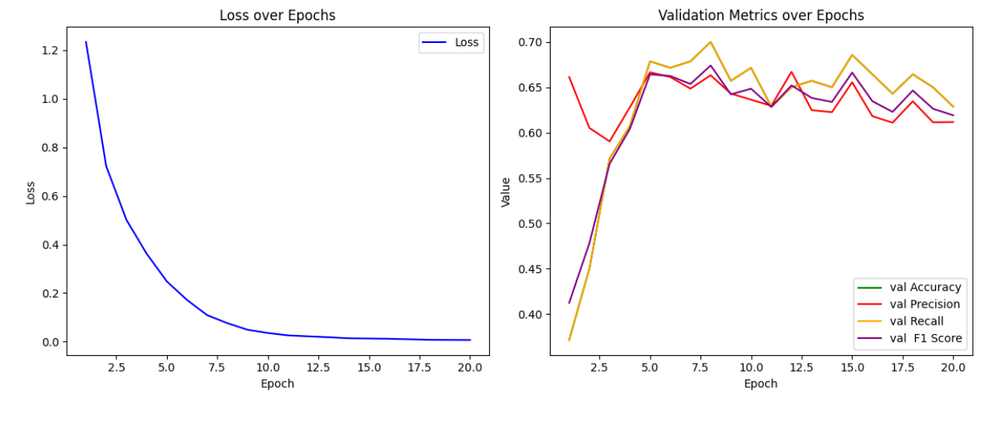
Model training
Loss, and accuracy for class is tracked during the training
Epoch 5 is the optimum value based on this plots. It’s always very useful to decide the optimal value based on loss and model’s performance on validation dataset

Slide 18
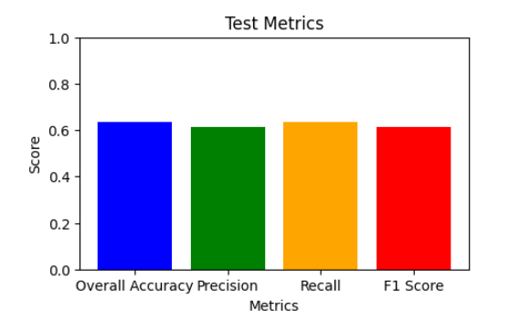
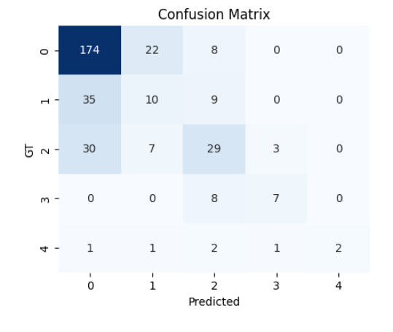
Model Evaluation
Loss, and accuracy for class is tracked during the training
It’s not good results. The model is learning, but it’s not that good, so it’s required to choose a different parameters/ model

Slide 19
Interpretation of the results
Anyone with any kind of diabetes can get diabetic retinopathy — including people with type 1, type 2, and gestational diabetes (a type of diabetes that can develop during pregnancy). [1] If the patient has a diabetes, then the model score will be interpreted as follows :
A high classification score (e.g., 3 or 4 ) from your model in a patient with diabetes becomes even more critical. With the high prevalence, it strongly suggests the presence of advanced DR, requiring urgent ophthalmological evaluation and potentially sight-saving interventions.
Due to the high likelihood of developing DR, a low score (e.g., 1 or 2) might not be entirely reassuring. It could indicate very early stages or no DR, but since most diabetics will develop it eventually, we can't be completely certain.
The model's score could be integrated with other risk factors like duration of diabetes, blood sugar control. This combined approach can better refine the interpretation.
[1] https://www.nei.nih.gov/learn-about-eye-health/eye-conditions-and-diseases/diabetic-retinopathy

Slide 20
Next Steps
Collect more data: from literature, there are around 5 other datasets publicly available.
Transfer learning from more similar tasks: explore transfer learning from models trained on tasks like vessels segmentation, or any other tasks more similar to this task
Hyper-parameter tuning: further tune the models with different loss function, optimisers, number of freezed layers, and etc
Perform more in depth EDA analysis
Refactor the code

